Slide 1
ONLY LIBERTARIANISM COHERES WITH THE COMMON SELF
Demarri Dosunmu

Slide 2

exigence
MORAL RESPONSIBILITY
When my mother yells at me for eating more birthday cake than was partitioned to me, she is holding me morally accountable for taking more than my share.
In doing so, she appeals to my moral intuitions about fairness and accountability.
By the same intuitions, if I were commanded by my father to do it, it was not of my free will and I am no longer responsible.
FREE WILL DEBATE
Though intuitions make use of an intuitive meaning of "free will," philosophers provide particular accounts for their position.
The details of these accounts may then contradict such meaning, thereby also contradicting moral intuitions.
In short, some positions might be morally useless.

Slide 3
Agenda
Positions
Religion
Language
Evolution
Analysis

Slide 4
POSITIONS
NAME | CAN WE HAVE FREE WILL WITH DETERMINISM? | HOLDERS
LIBERTARIANISM (INCOMPATIBILISM) | NO | Van Inwagen, Chisholm, Kane, Kant*
HARD DETERMINISM | NO | Spinoza
SOFT DETERMINISM (COMPATIBILISM) | YES | Leibnitz, Frankfurt, Dennett, Fischer, Lewis, Bok, P.F. Strawson, Ismael
— | YOU NEED DETERMINISM FOR FREE WILL | Hobbes, Hume, Smart, Ayer
IMPOSSIBILISM (HARD INCOMPATIBILISM) | DOESN'T MATTER | G. Strawson, Pereboom

Slide 5
RELIGION & SPRITIUALISM

Slide 6
RELIGION
NAME | ACCOUNT
CHRISTIANITY, JUDAISM | Man is created in the “image of God,” and “after His likeness;” imago Dei; derived form of agency and moral responsibility (Gen. 1:27, New International Version, 2011, R. Middleton, Simcha)
ISLAM | nafs refers literally to “soul,” “ego,” and “self”; "trust" given is faculty of uncaused agency (Qur’an 33:72; Assami, 2023)
HINDUISM | Atman: true, eternal self which underlies and transcends material psychology; pre-exists and is independent of all physical and mental processes (Radhakrishnan & Moore, 1957)

Slide 7
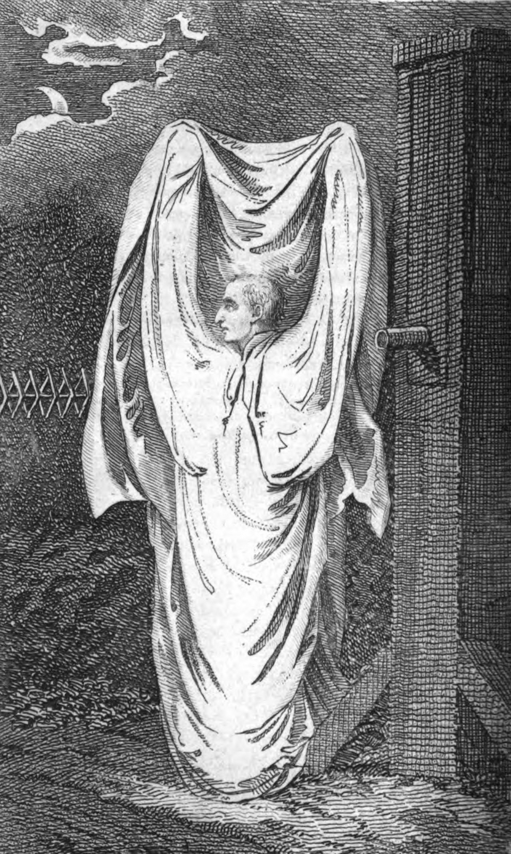
Agnosticism & atheism
SPIRITS, HAUNTINGS, AND GHOSTS:
Immaterial consciousness subsisting posthumously
Maintaining identity: "truer" version of the self
REINCARNATION:
A "core" identity which lives in different bodies with different memories yet responsibility-tracking
ANIMISM:
Spirits found in places, objects, or forces
Destroying land, plantlife immoral in similar way to mankind
Ubiquitous in preliterate societies (Bohannan & Glazer, 1988)

Slide 8
Are spirits uncaused?
Even if one believes in immaterial spirits, one may still believe in laws being applied to them
What would these "laws" be?
Would they affect the will?
How would we know such laws exist?
Social construction of spirits absolves empirical rule-checks
No reason to impose or theorize any law necessarily causing a spirit's behavior
Similarity to religious accounts
If people all over the world believe in spirits, and in the case of formalization by organized religion ascribe agent causation to them, then the convergence of agent-causal accounts suggests shared intuition regardless of religious status
Counterfactually: how likely is it that humans from different cultures and societies have the same conception of spirits if they do not share the intuition?

Slide 9
language

Slide 10
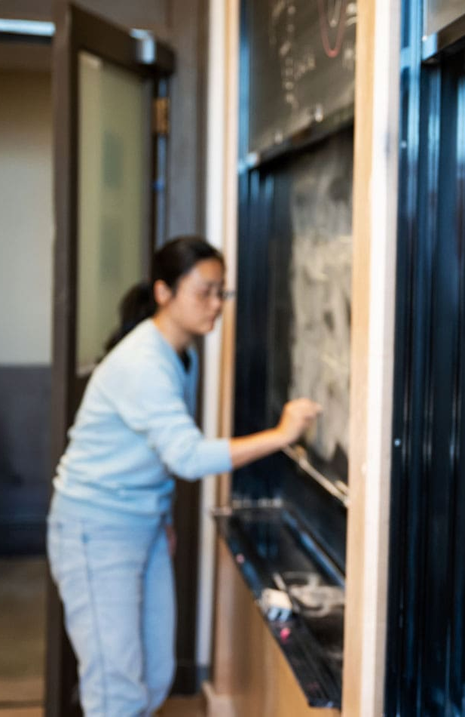
If I were...
COMMON LANGUAGE:
Language reveals assumptions we make via what things we do not question
SELF-COUNTERFACTUAL:
The speaker asks the audience to imagine a reality where speaker's physical existence is different
If the self is only the body, "if I were born differently" is a clear misuse of speech
Add mental content
"if I were my mathematics professor" does not allow a perspective change
you simply reassign personalities and memories
Requires a soul → aligns with previous section
"If I were my mathematics professor, I would treat the class better and use my intelligence for good."
Premise of media and research
Freaky Friday (Rodgers, 1972), Body Swap (McNicoll, 2018), 17 Again (Steers, 2009), perceptual research by Petkova and Ehrsson (2008)

Slide 11
evolution

Slide 12
Natural selection
THEORY:
Genetic mutations and birth conditions may improve an organism's chance of reproduction
Organisms with phenotypes toward reproduction replicate their genes at rates higher than those who haven't
MENTAL SELECTION:
Aspects of the human mind are also shaped by natural selection (similar to instincts in Darwin, 1859)
Case study: Morality
"Good," "bad," desert, and their non-negotiability are ineluctable throughout history, even between isolated groups
Morality guides human behavior toward social bonds and resource-sharing, increasing the probability of reproduction
Brain studies show how disorders such as NPD and ASPD are associated with lack of activation in brain regions responsible for empathy, critical to moral behavior (Jauk & Kanske, 2021)

Slide 13
WHY HUMANS?
MORALITY APPLIES ONLY TO HUMANS:
For animals it is greatly minimized
Only privation of suffering
Humans must possess a special quality
Feature which makes the investigation of their behavior more salient than the environment or earlier states
If this is the ability to generate will/behavior independent of other variables, humans will consider such cardinal
Result of temporal induction
Must investigate the patterns of such a will
Preexisting conditions are insufficient
STRENGTHENS MORALITY:
Humans are uniquely responsible for downstream results
Improves pro-social behavior and thence reproductive probability
If separate from the body (immaterial), empathetic counterfactuals are possible
How would I feel if I were them?
RECOVERABILITY
Manipulation or illness are mere conditions
Representative of current and future behavior
Yet victim's "true" will may not be visible because of mental conditions

Slide 14
Empirical support
Schooler and Vohs (2008)
Volunteers read a passage arguing for determinism; participants cheated nearly twice as often compared to a control group on later test, suggesting belief in determinism weakens moral accountability
Nadelhoffer et al. (2020): Questioned some of these conclusions, arguing that the effects of deterministic priming on immoral behavior such as cheating may not be as robust as initially suggested, potentially depending on subtle experimental conditions
Baumeister et al. (2009) replicated Schooler and Vohs' findings
Participants primed with deterministic ideas exhibited increased aggression and less willingness to help strangers compared to those primed with libertarian beliefs
Stillman et al. (2010)
Employees who self-reported stronger beliefs in libertarian accounts of free will had better job performance ratings and more positive career attitudes
Caspar et al., 2017; Hannikainen et al., 2019
Deterministic beliefs can negatively impact moral decision-making in various contexts (even if these effects vary in magnitude)

Slide 15
analysis

Slide 16

LIBERTARIANISM
“If determinism is true, no one can act otherwise than he does,” (van Inwagen, 1983, p. 106)
Expressed as “unmoved mover,” “prime mover,” or “uncaused cause.”
Coherent with religion, folklore, and spirits
Likely an effect of the laymen's account of the self
Natural significance of moral responsibility

Slide 17
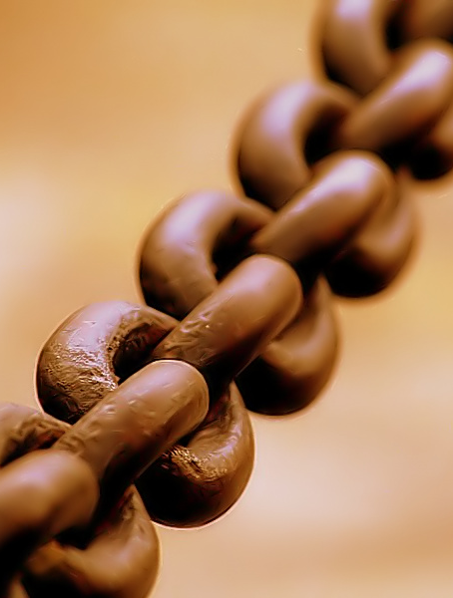
Hard determinism
All events exist in a causal structure
Free will does not exist
Incompatible with religion
Imposes laws upon socially-constructed souls
No empirical background
No non-practical reason to investigate human wills
Just look at their environment (metaphysically)

Slide 18

impossibilism
Free will is incoherent (G. Strawson, 1994)
Directly incompatible with agent-causal account of souls and spirits given by religion and folklore

Slide 19
compatibilism
Free will is exhibited by a self.
The intuitive metaphysical self is immaterial and not subject to deterministic laws.​
Determinism requires that all objects be subject to deterministic laws.​
Hence any self in compatibilism must be subject to deterministic laws.​
Therefore, the intuitive metaphysical self cannot exist in compatibilism.
Free will and determinism are not logically contradictory (McKenna, 2024)
Flexibility failure
Building of personality and character
Maps well onto reflexes, but contradictory to intuitive self's agent ability
Nuance: Frankfurt (1971), Fischer (2002)
Alignment of desires, guidance control
Victim to bypassing

Slide 20
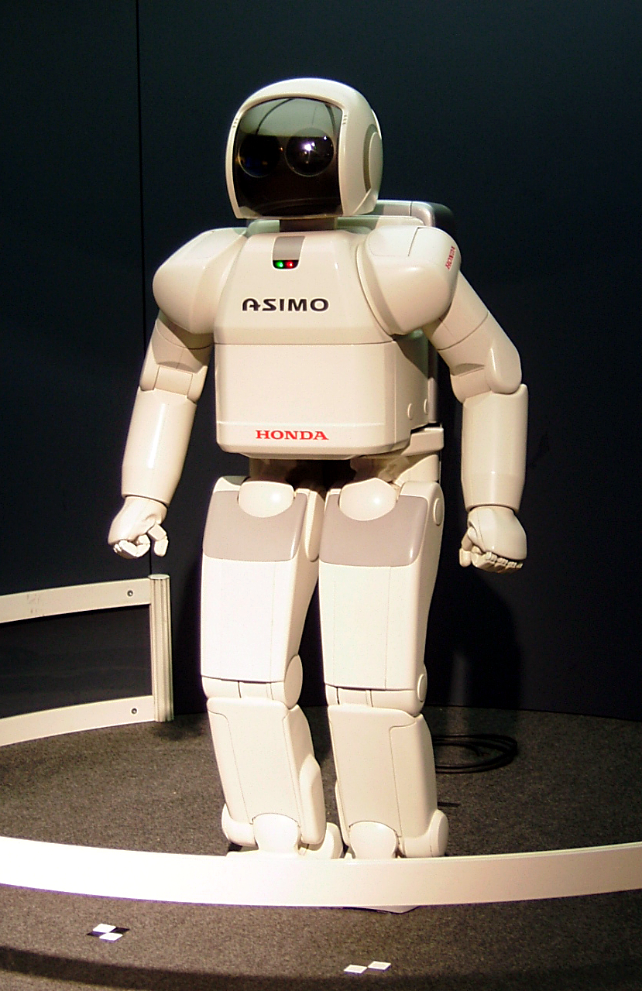
bypassing
Nichols & Knobe (2007)
Only 17% of individuals held an agent which existed in a fully deterministic universe responsible in an abstract scenario
Responsibility judgments rose above 70% when a small amount of uncaused agency was introduced
Woolfolk, Doris, & Darley 2006
When a murderer’s desires were inserted by outside manipulation, blame decreases greatly
Tracked by comprehension of determinism in five preregistered replications (Nadelhoffer et al. 2023)
Prometheus Conference 2026 - Demarri Dosunmu

Slide 21

CONCLUSION: INCOHERENCE
RANDOMNESS
Uncaused agency is random (reasonless)
Must be determined by reasons, beliefs, character traits, or desires
Otherwise choice is arbitrary; this is not genuine agency
That will begins in agents makes them the unique origin for events and uniquely responsible
Intuitive basis for moral responsibility
Natural selection has created an account for reproductive utility
Lacks logical consistency
Practical coherence of libertarianism outweighs the logical coherence of determinism

Slide 22
Q&A
Thank you!
Prometheus Conference 2026 - Demarri Dosunmu

Slide 23
American Psychiatric Association. (2013). Diagnostic and statistical manual of mental disorders (5th ed.). American Psychiatric Publishing.
Anstey, F. (1882). Vice Versâ, Or, A Lesson to Fathers.
Assami, E., & Amatullah Bantley. (2023). The Qur’an - English Meanings. Noble Quran Encyclopedia.
Baumeister, R. F., Masicampo, E. J., & DeWall, C. N. (2009). Prosocial Benefits of Feeling Free: Disbelief in Free Will Increases Aggression and Reduces Helpfulness. Personality and Social Psychology Bulletin, 35(2), 260–268. https://doi.org/10.1177/0146167208327217
Bohannan, P., & Glazer, M. (Eds.). (1988). High points in anthropology. McGraw-Hill.
Brady, T. (Director). (2002). The Hot Chick [Film]. Buena Vista Pictures.
Buckner, R. L., & Carroll, D. C. (2007). Self-projection and the brain. Trends in Cognitive Sciences, 11(2), 49–57. https://doi.org/10.1016/j.tics.2006.11.004
Caspar, E. A., Vuillaume, L., Magalhães De Saldanha da Gama, P. A., & Cleeremans, A. (2017). The Influence of (Dis)belief in Free Will on Immoral Behavior. Frontiers in Psychology, 8. https://doi.org/10.3389/fpsyg.2017.00020
Darwin, C. (1859). On the Origin of Species. Alma Classics. (Original work published 1859)
Pereboom, D. (2001). Living without free will. Cambridge University Press.
Hannikainen, I. R., Machery, E., Rose, D., Stich, S., Olivola, C. Y., Sousa, P., Cova, F., Buchtel, E. E., Alai, M., Angelucci, A., Berniûnas, R., Chatterjee, A., Cheon, H., Cho, I.-R., Cohnitz, D., Dranseika, V., Eraña Lagos, Á., Ghadakpour, L., Grinberg, M., & Hashimoto, T. (2019). For Whom Does Determinism Undermine Moral Responsibility? Surveying the Conditions for Free Will Across Cultures. Frontiers in Psychology, 10(2428). https://doi.org/10.3389/fpsyg.2019.02428
Holton, R. (2009). Willing, wanting, waiting. Clarendon Press.
Jauk, E., & Kanske, P. (2021). Can neuroscience help to understand narcissism? A systematic review of an emerging field. Personality Neuroscience, 4(3). https://doi.org/10.1017/pen.2021.1
McIntyre, A., Fischer, J. M., & Ravizza, M. (2000). Responsibility and Control: A Theory of Moral Responsibility. The Philosophical Review, 109(2), 267. https://doi.org/10.2307/2693582
McKenna, M., & Coates, D. J. (2024). Compatibilism (E. N. Zalta & U. Nodelman, Eds.). Stanford Encyclopedia of Philosophy; Metaphysics Research Lab, Stanford University. https://plato.stanford.edu/archives/sum2024/entries/compatibilism/
McNicoll, S. (2018). Body swap. Dundurn Press.
Nadelhoffer, T., Rose, D., Buckwalter, W., Nichols, S., & Shepard, J. (manuscript under review). Bypassing and blame: A preregistered investigation of determinism’s effect on folk moral judgments. Manuscript under review, Department of Philosophy, College of Charleston.
Prometheus Conference 2026 – Demarri Dosunmu

Slide 24
Nadelhoffer, T., Shepard, J., Crone, D. L., Everett, J. A. C., Earp, B. D., & Levy, N. (2020). Does encouraging a belief in determinism increase cheating? Reconsidering the value of believing in free will. Cognition, 203, 104342. https://doi.org/10.1016/j.cognition.2020.104342
Nichols, S., & Knobe, J. (2007). Moral Responsibility and Determinism: The Cognitive Science of Folk Intuitions. Nous, 41(4), 663–685. https://doi.org/10.1111/j.1468-0068.2007.00666.x
van Inwagen. (1983). An essay on free will (p. 56). Oxford Clarendon Press.
Petkova, V. I., & Ehrsson, H. H. (2008). If I Were You: Perceptual Illusion of Body Swapping. PLoS ONE, 3(12), e3832. https://doi.org/10.1371/journal.pone.0003832
Petrie, M., & Halliday, T. (1994). Experimental and natural changes in the peacock’s (Pavo cristatus) train can affect mating success. Behavioral Ecology and Sociobiology, 35(3), 213–217. https://doi.org/10.1007/bf00167962
Rodgers, M. (2009). Freaky Friday. Bowen Press, An Imprint Of Harpercollins Publishers.
Sarvepalli Radhakrishnan, & Moore, C. A. (1989). A sourcebook in Indian philosophy. Princeton University Press.
Steers, B. (Director). (2009). 17 Again [Film]. New Line Cinema.
Stillman, T. F., Baumeister, R. F., Vohs, K. D., Lambert, N. M., Fincham, F. D., & Brewer, L. E. (2010). Personal Philosophy and Personnel Achievement: Belief in Free Will Predicts Better Job Performance. Social Psychological and Personality Science, 1(1), 43–50. https://doi.org/10.1177/1948550609351600
Strawson, G. (1994). The impossibility of moral responsibility. Philosophical Studies, 75(1-2), 5–24. https://doi.org/10.1007/bf00989879
The Holy Bible: New International Version. (2011). Zondervan.
Vohs, K. D., & Schooler, J. W. (2008). The Value of Believing in Free Will. Psychological Science, 19(1), 49–54. https://doi.org/10.1111/j.1467-9280.2008.02045.x
Williams, P., Tribe, A., & Wynne, A. (2002). Buddhist Thought. Routledge.
Woolfolk, R. L., Doris, J. M., & Darley, J. M. (2006). Identification, situational constraint, and social cognition: Studies in the attribution of moral responsibility. Cognition, 100(2), 283–301. https://doi.org/10.1016/j.cognition.2005.05.002
https://en.wikipedia.org/wiki/Chain
https://upload.wikimedia.org/wikipedia/commons/5/5b/Lorenz_attractor_yb.svg
https://www.pikist.com/en-clipart-oy4qs
https://en.wikipedia.org/wiki/Robot
https://robertglazer.com/friday-forward/the-fork-in-the-road/
https://mathematics.jhu.edu/
https://en.wikipedia.org/wiki/Ghost
https://www.chronicle.com/article/johns-hopkins-just-got-the-largest-donation-ever-given-to-a-philosophy-department/
Prometheus Conference 2026 – Demarri Dosunmu

